Slide 1
History of Programming
INTRODUCTION TO PROGRAMMING WITH C – BICT 1102
Lecturer: Mr Khwima Mkamanga., MSc Information Technology Management, Cardiff Metropolitan University, UK
Ass. Lecturer : Mr. Lloyd Chunga

Slide 2
Learning Objectives
In this chapter you will learn about:
Describing Programming language
Language Models
Chronology of Programming
Object Oriented Concepts
Classes
Encapsulation (or Information Hiding) and Abstraction
Messages and Operations
Relationships
Polymorphism

Slide 3
Describing Programming language
Programming languages are special computer languages designed for writing software programs that tell computers what to do.
There are many different programming languages, each with its own syntax, semantics, and features.
Computers consists of;
1s and 0s or the binary system, which human beings would find very difficult to communicate in.
Programming languages enable humans to write in a form that is more compatible with the human system of communication.
This is then translated into machine code that the computer can understand.

Slide 4
Describing Programming Languages (continued)
Programming languages are typically implemented by compilers or interpreters, which translate source code into executable machine code.
Understanding programming languages and their features is essential for software developers to choose the right language for a given task and write high-quality, efficient code.

Slide 5
Language Models
Programming languages can be categorized into different language models or paradigms, such as procedural, functional, and object-oriented programming.
Imperative/Procedural languages:
Formed from collections of basic commands, most often assignments and Input/Output (I/O), where execution is sequenced by control structures (e.g. loops, conditionals, blocks).
Specify explicit sequences of steps to follow to produce a result. Examples include: - C, Pascal, Fortran, Assembly
Functional Languages:
Consists of a collection of mathematical function definitions and function applications.
Programs written in a functional language are generally compact and elegant, but have tended, until recently, run slowly and require a lot of memory. Examples include LISP, Haskell, Scheme.
Logic programming languages:
Consists of a collection of statements with a particular mathematical logic.
Original logic programming language was Prolog.

Slide 6
Language Models (continued)
Object-Oriented (OO) languages:
Consists of objects that interact with each other. Examples include Simula, Smalltalk-80, C++, Java.
Declarative languages:
Consists of a collection of declarations, i.e. program specifies what is to be done rather than how to do it. - Many functional and logic languages are also declarative.
Examples include Haskell, Prolog.
Scripting languages:
Controls a software application which is usually written in a different language.
Scripting languages came about largely because of the development of the Internet as a communication tool.
Examples include JavaScript, Perl, PHP.
Parallel languages:
Operate on the principle that large problems can often be divided into smaller ones, which are then solved concurrently ("in parallel").
An example is Ada
Consists of a collection of processes (sometimes structure data) that communicate with each other.

Slide 7
Chronology of Programming
The Chronology of programming represents: -
Major steps or ‘generations’ in the evolution of programming languages.
The language generations span many decades, and begin with the development of machine code.
Each generation adds new features and capabilities.
For example, modern languages have led to the development of completely different styles of programming involving the use of more human-like or natural language and re-usable pieces of code.

Slide 8
Chronology of Programming (continued)
First generation languages (1GL):
Was machine language, instructions and addresses were numerical.
These programs were linked to the machine they were developed on.
Second generation languages (2GL):
Allowed symbolic instructions and addresses.
An assembler translated the programs into machine codes.
Languages of this generation include IBM, BAL and VAX Macro.
Languages were still dependent on the machine they were developed on.
A typical 2GL instruction looks like this: ADD 12, 8
Third generation languages (3GL): -
Also called high-level programming languages.
All 3GL are much easier for the human being to understand.
Not machine dependent, and as such, allows programmers to concentrate on the problem rather than the machine they writing for.
3GL include FORTRAN, COBOL, Pascal, Ada, C and BASIC.
A compiler converts the statements of a specific high-level programming language into machine code

Slide 9
Chronology of Programming (continued)
Fourth generation languages (4GL): -
These are known as non-procedural, they concentrate on what you want to do rather than how you are going to do it.
Designed to be closer to natural language than 3GL language.
Languages for accessing databases are often described as 4GLs.
4GL languages include SQL, Postscript.
Fifth generation languages (5GL): -
Did not appear until 1990s - Contain visual tools to help in developing a program.
Have primarily been concerned with Artificial Intelligence and Fuzzy logic.
Languages in this generation have explored natural languages, making the computer seem to communicate like a human being.
A good example of a fifth generation language is Visual Basic.
A compiler is also used to covert statements of 5GL to machine code

Slide 10
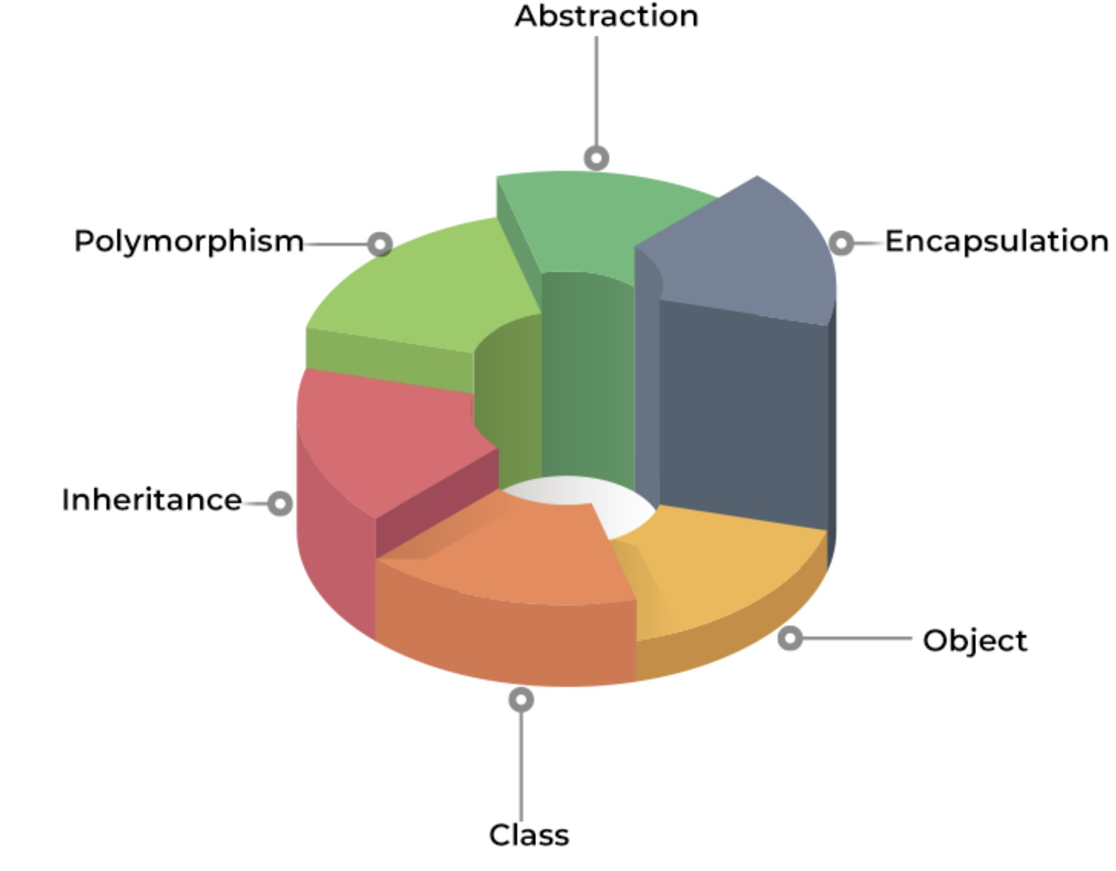
Object Oriented Concepts
Object-oriented programming (OOP) is a powerful paradigm used by many modern programming languages. In OOP, programs are organized around objects, which represent real-world entities and contain both data and behaviors.
The basic building block of OOP is the class, which defines the structure and behavior of objects. A class is like a blueprint for an object, containing information about its properties and methods.
Objects can interact with each other through messages and methods. A message is a request for an object to perform a certain action, and a method is the code that performs the requested action.
A pictorial representation of an OOP implementation

Slide 11
OOP - Classes
In OOP, a class is a blueprint for creating objects
It defines the attributes and methods that all objects of that class will have
Classes can inherit from other classes, which allows them to reuse code and share functionality
The inheritance relationship between classes is often depicted using a class hierarchy or inheritance tree
For Example: Consider the Class of Cars. There may be many cars with different names and brands but all of them will share some common properties like all of them will have 4 wheels, Speed Limit, Mileage range, etc. So here, Car is the class, and wheels, speed limits, mileage are their properties.

Slide 12
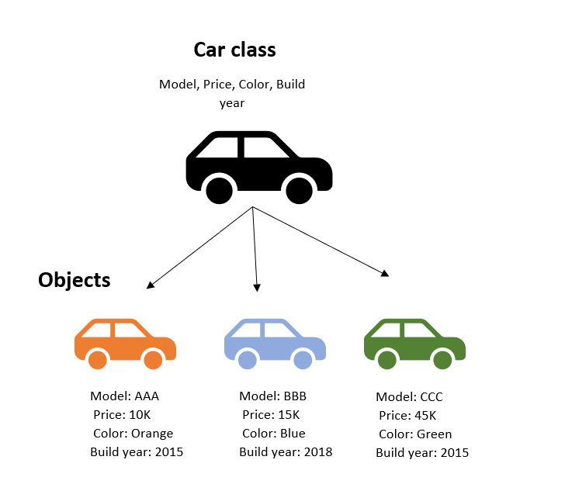
OOP – Classes (continued)

Slide 13
Encapsulation (or Information Hiding) and Abstraction
Encapsulation is a key concept in OOP that refers to the idea of bundling data and methods together and hiding them from outside access. This helps to ensure that data is only accessed and modified in the intended ways.
Encapsulation allows us to create objects that are self-contained and can be used by other parts of a program without needing to know the details of how they work internally.
Abstraction is another key concept in OOP that refers to the idea of hiding unnecessary details and exposing only the relevant information. This helps to simplify programming and reduce complexity.
Abstraction can be achieved through the use of interfaces or abstract classes, which define a set of methods that a class must implement but do not provide any implementation details.

Slide 14
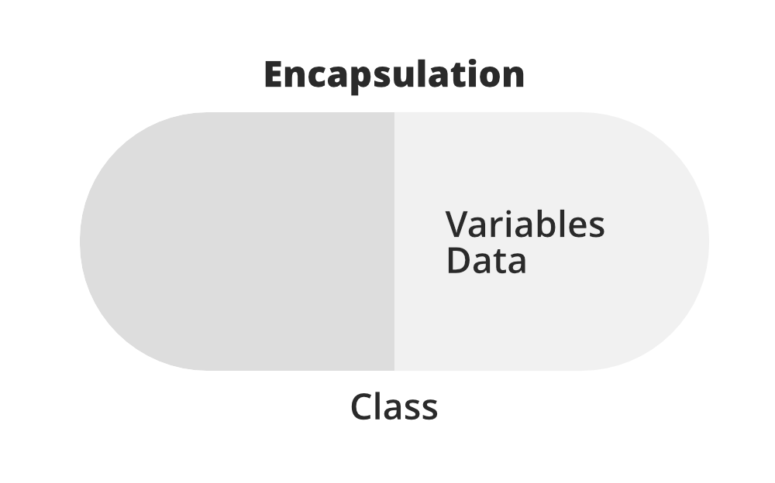
OOP - Encapsulation (or Information Hiding) and Abstraction (continued)

Slide 15
Messages and Operation
In OOP, objects communicate with each other through messages and methods. A message is a request for an object to perform a certain action, and a method is the code that performs the requested action.
For example, a car object might receive a message to start its engine, which would trigger the start method. The method would then carry out the necessary steps to start the engine, such as activating the starter motor and fuel injection system.
In C++, messages and methods are defined using function syntax. A method is a function that is defined as part of a class and operates on the object itself.

Slide 16
Relationships
Objects can have relationships with each other, such as inheritance and composition.
Inheritance is a mechanism that allows a class to inherit properties and methods from a parent class. This allows for code reuse and helps to simplify programming.
Composition is a mechanism that allows a class to contain one or more other objects as members. This allows for greater flexibility and modularity in programming.
Inheritance allows for code reuse and specialization.
For example, a car class can inherit from a vehicle class and add specific features like doors or wheels. A subclass or child class can also override or modify the inherited behavior of its superclass.

Slide 17
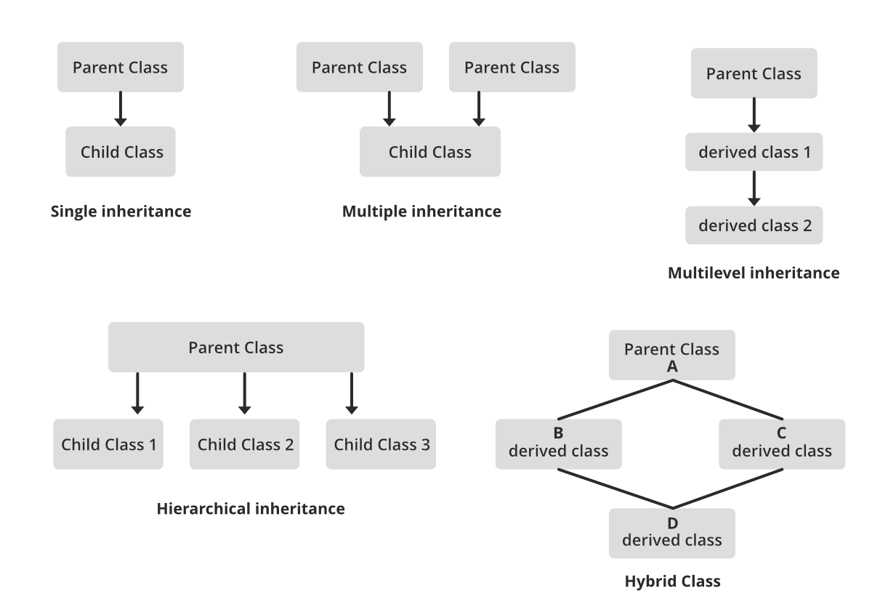
Relationships (continued)

Slide 18
OOP - Polymorphism
The word polymorphism means having many forms.
Polymorphism is a powerful concept in OOP that allows objects of different types to be treated as if they were the same type. This allows for greater flexibility in programming and can help to simplify code.
There are two types of polymorphism: compile-time (or static) and runtime (or dynamic) polymorphism. Compile-time polymorphism is achieved through function overloading and templates, while runtime polymorphism is achieved through virtual functions and inheritance.

Slide 19
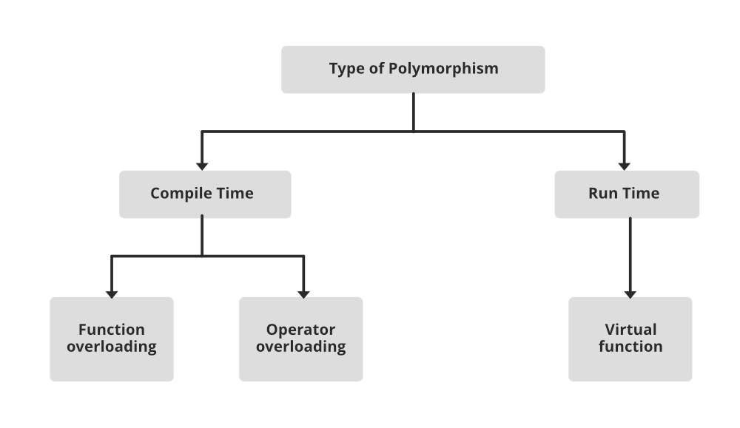
OOP – Polymorphism (continued)

Slide 20
Summary
You have now learned about the history of programming and the exciting world of object-oriented programming.
Understanding these concepts is essential for any programmer and will help you to write more efficient, flexible, and maintainable code.

